Slide 1

Report for BFX-AT100 - Dec 2022 Mass Production Inspection
FOXCONN CPEG JBD_VN
Apr 03, 2023

Slide 2
Establish the Team
Team Leader
Team Member
PE: Michael, Nam
ME: Cheng Lun, Hugo
PM: An Tran, Yuri
PD: Wen Yong
QA: Ken, Robert
TE: Mark, Jones
IE: Hai Ly, Heng Ruan
Foxconn
  MFG Manager : David Yin
  QA Manager : Toney Tu/ CB Lin

Slide 3
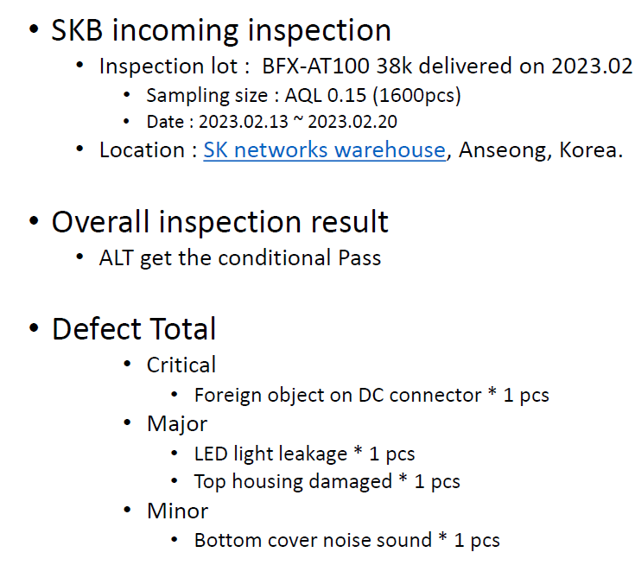
Description of Problems
Issue Description
On Feb 23, 2023 ALT customer feedback about Mass Production Inspection for shipment lots in Feb-2023 Detail as below:

Slide 4
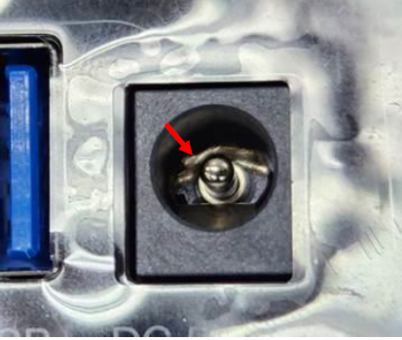
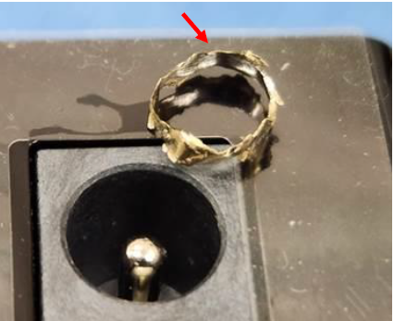
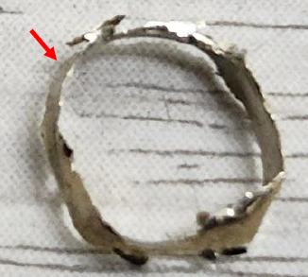
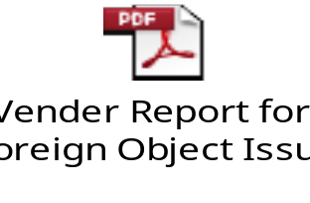
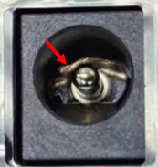
Failure Analysis Report
1. Foreign object on DC connector
Issue Description | Root cause | Actions | Status
Symptom: No power when fully inserted DC connector. Defect Q’ty : 1/1600pcs Defect rate : 0.06% SN : 2149688001202301025302 | During inspection process, ALT customer detected one unit was no power due to have foreign object inside DC connector, after customer removed foreign object this unit operates normal. Fii check production data: this unit passed all test stations smoothly. At test station, the product got the power and testing normal. VI OP didn’t detect foreign object inside DC connector. After that, Fii sent NG picture to DC connector vendor (Powerway) for further analysis and the result is the foreign object inside DC connector is probe copper ring of testing machine from vender side. Detail as vender report: Conclusion: The foreign object inside DC connector is from incoming material (vendor: Powerway). VI operator didn’t detect foreign object inside DC connector lead to escape this issue. | Vender actions: Increase the service life control of the test probe (adjust to 50,000 times) to prevent the copper ring from falling off due to excessive use of the test probe. (Done). Make the bad anomaly as "bad Kanban" for internal promotion, and hang it on the production site to alert operators and check the wear/damage of the test probe at any time. (Done). Fii action: add NG picture in SOP at VI station and re-train OP to inspect careful at DC connector location. (Done). | Monitor
NG

Slide 5
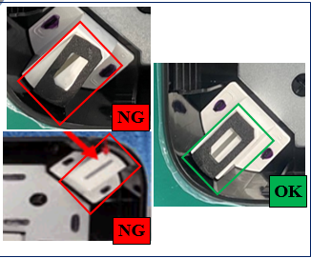
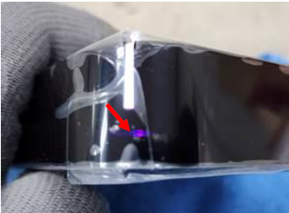
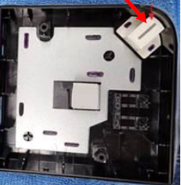
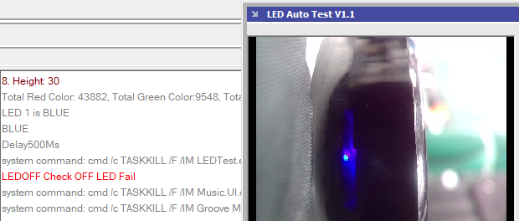
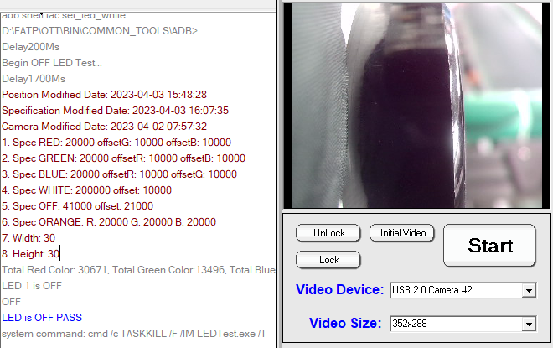
Failure Analysis Report
2. LED light leakage
Issue Description | Root cause | Actions | Status
Symptom: LED light leakage when operation Defect Q’ty : 1/1600pcs Defect rate : 0.06% SKB SN: SN :2149688001202301034831 | Occur Root Cause : After ALT customer was opened housing and detected The gasket was missing, ALT Re-attached gasket then assembled again, didn’t find LED light leakage issue. Therefore, it maybe due to operator when assembly forgot attach the gasket. Escape Root Cause : Test program in production line can not cover LED light leakage issue. | Action for occur: Add notice in SOP and Re-train operators, “Must check the gasket was attached well before assembly the top case”. (Done) Action for Escape: Add one more item in test program to check and cover Led light leakage issue automatically.(Done) | On- going
Test program checks and detects Led light leakage
=> test result: Fail
Test program checks and don’t detect Led light leakage
=> test result: Pass

Slide 6
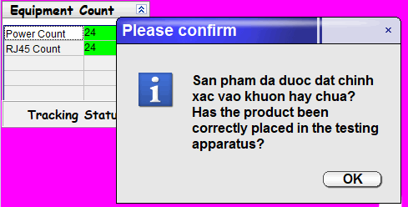
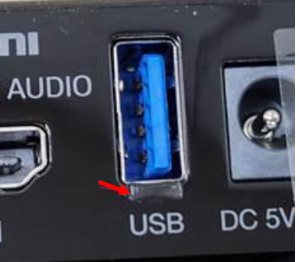
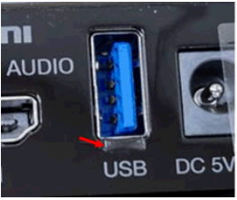
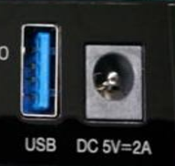
Failure Analysis Report
3. Top housing damaged
Issue Description | Root cause | Actions | Status
Symptom: Physical damage on USB connector area Defect Q’ty : 1/1600pcs Defect rate : 0.06% SN: 2149688001202301024991 | Occur Root Cause : When start the testing process the test fixture will keep the device on test fixture to move to the power ports was fixed on test machine for test. However, operator putted device was misalign with test fixture, (device did not fix full 100% with test fixture due to Op putted misalign). Therefore, when start testing, the power port on test machine will touch with housing at USB connector area due to the device on test fixture was putted misalign by operator, it leads to physical damage on housing at USB connector area. Escape Root Cause : VI operator did not detect this issue. | Action for occur: Add one notice on test program before start testing to remind OP check the device was placed correct on test fixture or not. (Done) Add notice in SOP and Re-train operators, “Must inspect careful at the connector positions”. (Done) | Open
NG
OK

Slide 7
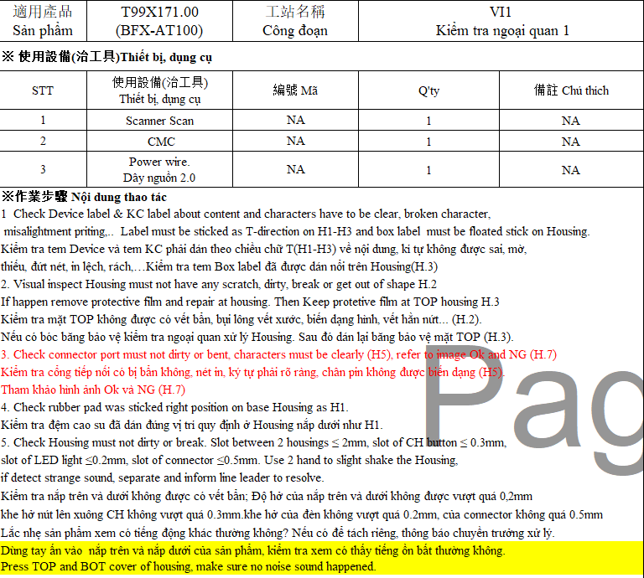
Failure Analysis Report
4. Bottom cover noise sound
Issue Description | Root cause | Actions | Status
Symptom: Makes a noise sound when the bottom cover is pressed Defect Q’ty : 1/1600pcs Defect rate : 0.06% SKB SN: SN:2149688001202301017824 | During inspection process, ALT customer detected one unit had a noise sound when the bottom cover is pressed. After customer re-assemble bottom cover, didn’t find the noise sound when the bottom cover is pressed again. It maybe due to OP didn’t fix correct 100% when assembling top cover with bottom cover. | Re-train OP and request OP at VI station must press bottom cover whether happen noise sound or not. (Done). | Monitor

